Slide 1
Chi-Squared Test
(it’s a square, get it?!)

Slide 2
Types of Chi Squared Test
Independence / Association / Homogeneity: Is there a relationship between two categorical variables (Left/right handed vs Pepsi/Coke)
Goodness of Fit: Does an observed distribution fit an expected / theoretical distribution? (Is data uniformly distributed? Poisson distributed?)

Slide 3
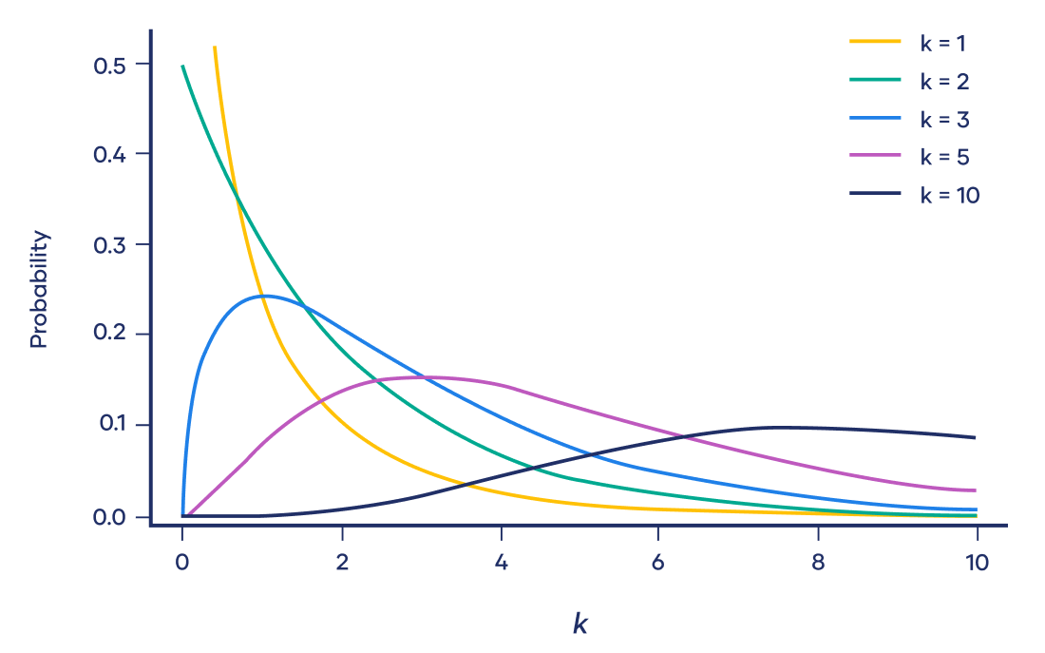
Assumptions
Data are categorical
Data are in counts / frequencies (not percentages or continuous values)
Observations are independent
Expected frequencies > 5

Slide 4
Test of Association…
H0: There is no association / groups are independent
HA: There is an association / groups are not independent
 | Dogs | Cats
Males | 26 | 24
Females | 29 | 21

Slide 5
Pet Ownership by Gender - Is there a difference?
 | Dogs | Cats
Males | 26 | 24
Females | 29 | 21
 | Dogs | Cats | Totals
Males | 26 | 24 | 50
Females | 29 | 21 | 50
Totals | 55 | 45 | 100

Slide 6
Expected Counts
Observed | Dogs | Cats | Totals
Males | 26 | 24 | 50
Females | 29 | 21 | 50
Totals | 55 | 45 | 100
Expected counts = (Row total X Column total) / (Total) Total
Expected | Dogs | Cats
Males | 27.5 | 22.5
Females | 27.5 | 22.5

Slide 7

Calculating The Chi-Square Statistic
For each cell:
Calculate observed minus expected
Square the differences
Divide by expected
Sum up all the values
Chi Square Test Statistic= .364
Compare to Chi Square Critical Value for given alpha and degrees of freedom = 3.841
DoF = (rows - 1) * (columns -1) = 1
Reject the null that there is no association if Stat > CV
Conclusion: Fail to reject the null that there is a significant difference
 | Dog | Cat
Male | 0.082 | 0.1
Female | 0.082 | 0.1

Slide 8
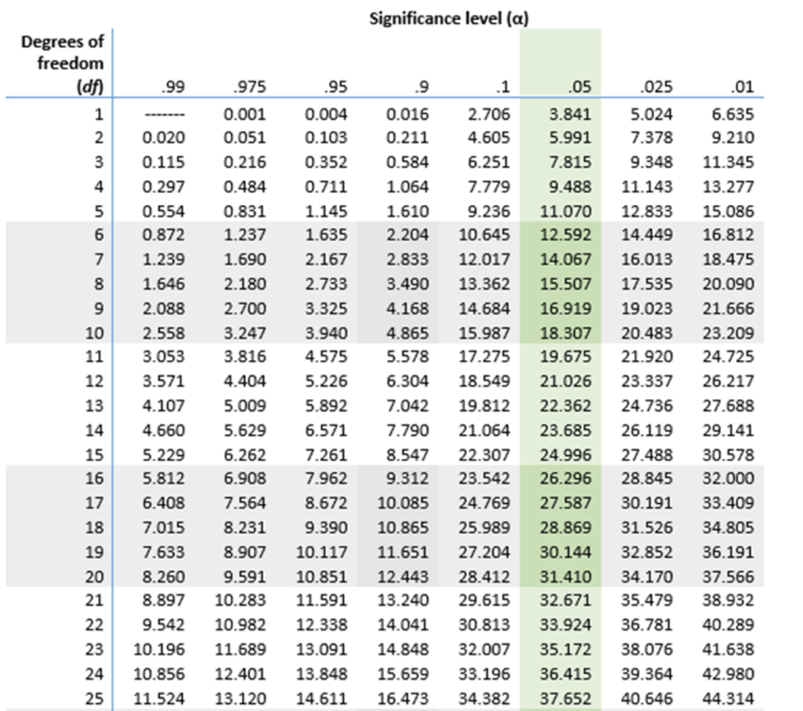
Chi Square Table

Slide 9
Example 2: Test of Association…
Is there a difference in the preference distribution for men and women?
 | Apples | Bananas | Cherries | Total
Male | 17 | 24 | 9 | 50
Female | 19 | 14 | 17 | 50
Total | 36 | 38 | 26 | 100
Notes:
• If you're thinking, "homogeneity and independence sound the same!", you're nearly right. The difference is a matter of design. In the test of independence, observational units are collected at random from a population and two categorical variables are observed for each unit. In the test of homogeneity, the data are collected by randomly sampling from each sub-group separately. (Say, 100 blacks, 100 whites, 100 American Indians, and so on.) The null hypothesis is that each sub-group shares the same distribution of another categorical variable. (Say, "chain smoker", "occasional smoker", "non-smoker".) The difference between these two tests is subtle yet important.

Slide 10
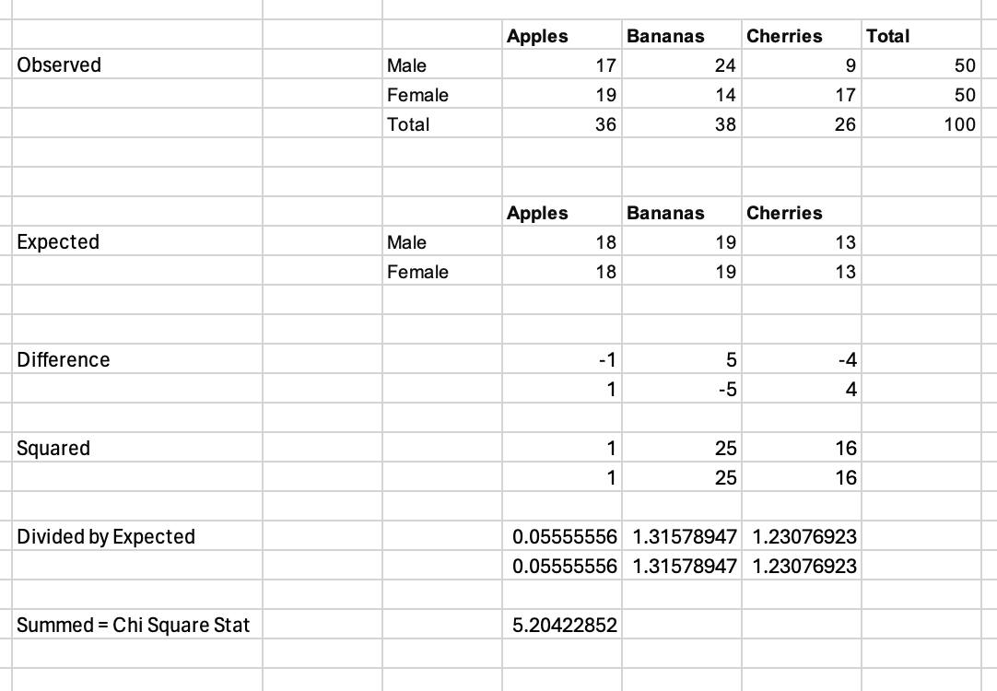
Calculating The Chi-Square Statistic
For each cell:
Calculate expected ((row total x column total) / total)
Calculate observed minus expected
Square the differences
Divide by expected
Sum up all the values
Chi Square Test Statistic= 5.204
Compare to Chi Square Critical Value for given alpha and degrees of freedom = 5.991
DoF = (rows - 1) * (columns -1) = 2
Reject the null if Stat > CV
Conclusion: Fail to reject the null that each group has the same distribution

Slide 11
DoF = 2
CV = 5.991
Stat = 5.204

Slide 12
Chi Square Table

Slide 13
2) Test of Goodness of Fit
H0: Observed frequencies follow expected / theoretical distribution
HA: Observed frequencies do not follow expected / theoretical distribution
Dice Side | Observed | Expected
1 | 17 | 100/6 = 16.6
2 | 14 | 16.6
3 | 15 | 16.6
4 | 17 | 16.6
5 | 19 | 16.6
6 | 18 | 16.6

Slide 14
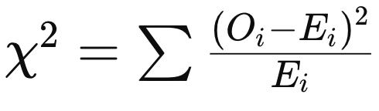
Dice Side | Observed | Expected | Difference | Diff Squared | DS / E
1 | 17 | 16.6 | 0.4 | 0.16 | 0.00963855
2 | 14 | 16.6 | -2.6 | 6.76 | 0.40722892
3 | 15 | 16.6 | -1.6 | 2.56 | 0.15421687
4 | 17 | 16.6 | 0.4 | 0.16 | 0.00963855
5 | 19 | 16.6 | 2.4 | 5.76 | 0.34698795
6 | 18 | 16.6 | 1.4 | 1.96 | 0.11807229
Summed DS/E = Chi Square Statistic = 1.0458
Compare to Chi Square Critical Value for given alpha and degrees of freedom = 11.07
DoF = number of categories - 1* = 6 - 1 - 5
Reject the null that the observed frequencies follow the expected frequencies if Stat > CV
Conclusion: Fail to reject the null = dice seem fair
Notes:
DoF = categories - parameters estimated in obtaining expected frequencies - 1

Slide 15
Dice Side | Observed | Expected | Difference | Diff Squared | DS / E
1 | 24 | 16.6 | 7.4 | 54.76 | 3.298795181
2 | 19 | 16.6 | 2.4 | 5.76 | 0.346987952
3 | 6 | 16.6 | -10.6 | 112.36 | 6.768674699
4 | 25 | 16.6 | 8.4 | 70.56 | 4.25060241
5 | 3 | 16.6 | -13.6 | 184.96 | 11.14216867
6 | 23 | 16.6 | 6.4 | 40.96 | 2.46746988
Summed DS/E = Chi Square Statistic = 28.27
Compare to Chi Square Critical Value for given alpha and degrees of freedom = 11.07
DoF = number of categories - 1* = 6 - 1 - 5
Reject the null that the observed frequencies follow the expected frequencies if Stat > CV
Conclusion: Reject the null = dice do not seem fair
Notes:
DoF = categories - parameters estimated in obtaining expected frequencies - 1

